Slide 1
Job Hunt App
Batch 96
-------------------------
Guided By,
Tarun Kumar
 | Group Members: Viji C Murugan K Vaibhav Singh Chauhan

Slide 2


Slide 3

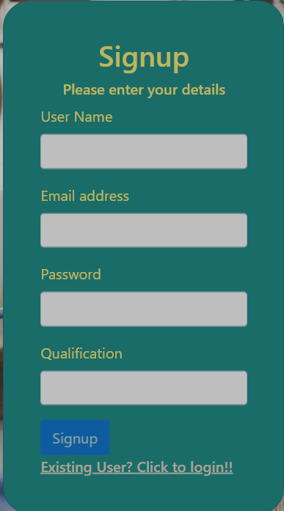

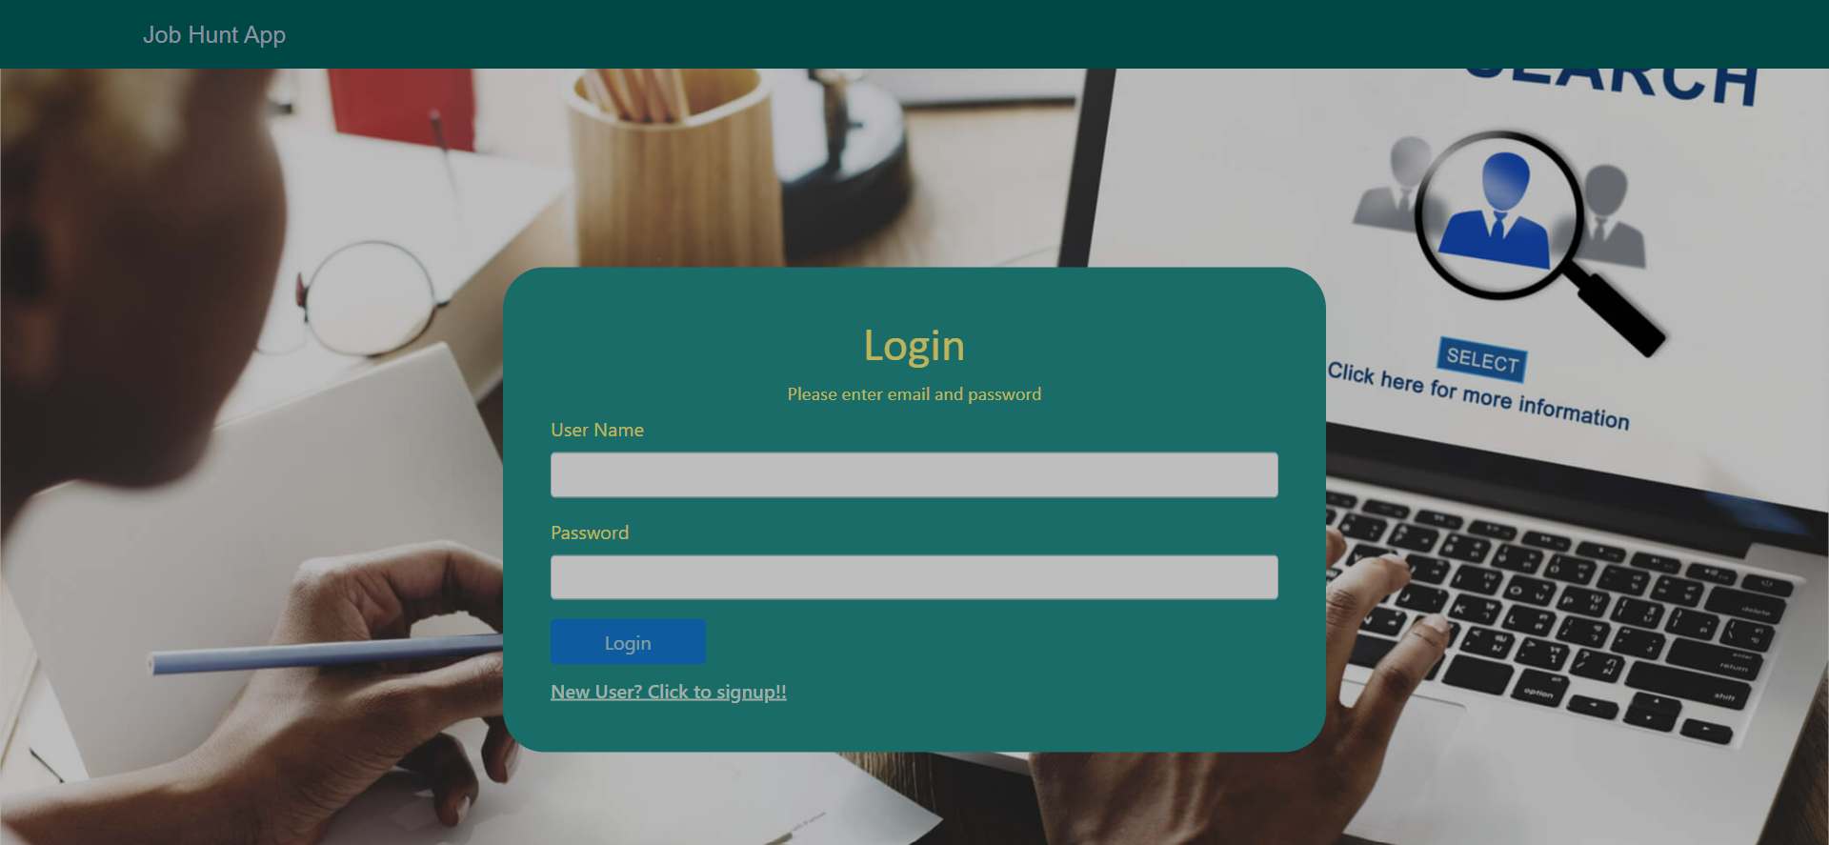

Slide 4
Outline
Problem Statement
Objective
Microservices
Project Overview
Architecture
Application Flow
Technology and Tools Used
Conclusion

Slide 5

Problem Statement
1) A user wanted to search for a job through online mode using an app.
2) Home Page should consist of Register page link through which a user can register himself. Upon registration, the user able to login into his account.
3) User home page should also have options for to edit his profile and changing his password.
Problem Statement

Slide 6
Objective
Our objective is to provide best user experience to X so that X can search and apply for a job online.

Slide 7
oervices
Authentication API
Wishlist API
External API
API Gateway
Discovery service
Micro Services

Slide 8
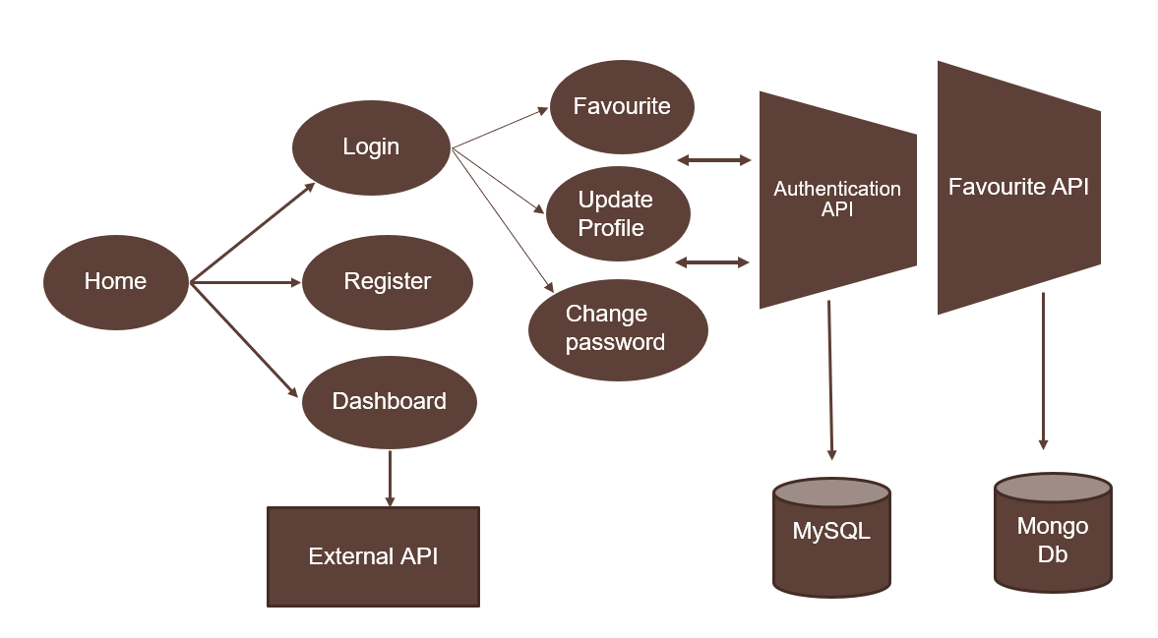
Project Overview

Slide 9
High Level Architecture Diagram

Slide 10
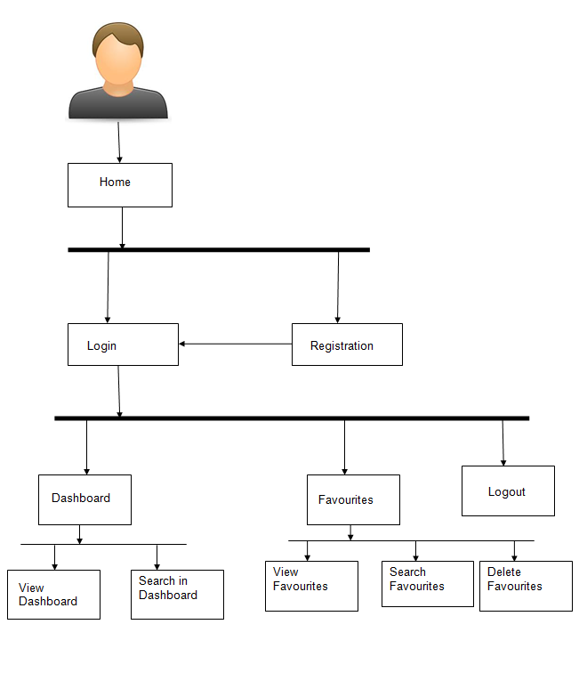
Project Flow
Login
Register
Wishlist
Home
profile
Recommends
View Favorites
Delete Favorites
Edit account
Change password
Search Books

Slide 11







Technologies and Tools Used

Slide 12
Conclusion
The Job-hunt app helps the user to search and apply jobs
online. It also helps user to store the best jobs in wishlist
and delete them afterwards.

Slide 13
Thank You

Slide 14


